Slide 1
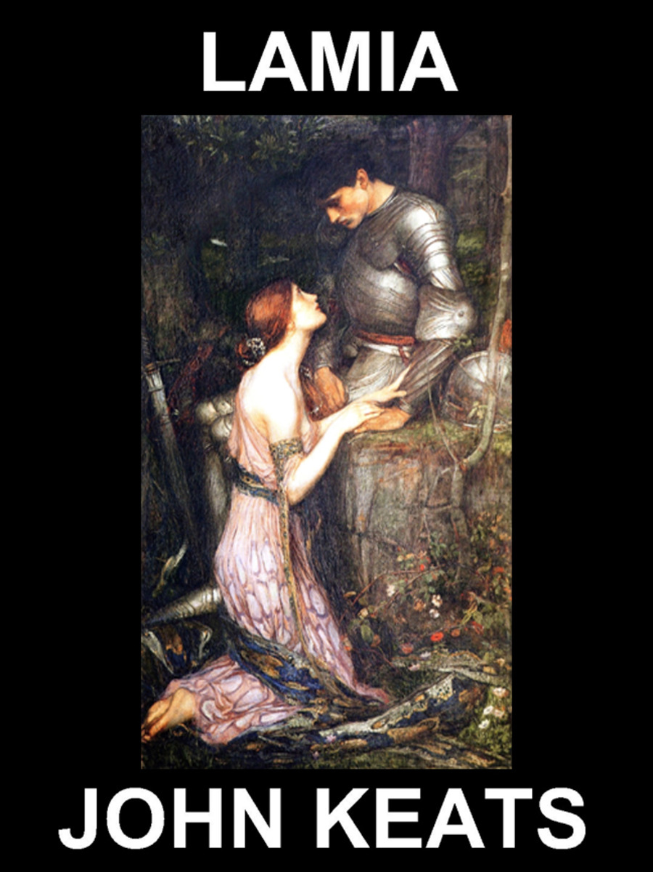
B.A 1
UNIT 1
BY DR.PATWARI YADAV
ASSOCIATE PROFESSOR
DEPARTMENT OF ENGLISH
PURNEA COLLEGE, PURNEA

Slide 2
POET’S INTRODUCTION

Slide 3
Who is Lamia?
Lamia is a devastatingly beautiful monster, part woman and part serpent. Before she was cursed with her terrible new form, she was a powerful but relatively innocent woman. Now, she is a bloodthirsty villain who slithers through the darkness of the night, searching for children to devour, or walks in beauty through the daylight, searching for men to make her dessert.

Slide 4
Physical Description of lamia
According to ancient Greek tradition, Lamia has the head and breasts of a woman, but the rest of her body is serpentine. By some accounts, her chimeric form is hideous, but other writers seem to have been mesmerized by her form, even describing her scales as precious gems and the coils of her body as graceful.

Slide 5
Other Greek writers abandon the snake’s body entirely, merely writing that Lamia’s face became evil and contorted when she began her first murdering spree. Her face may have also been disfigured by the loss of her eyes; in some myths, she tore them out with grief for her own children, and in others, Zeus gave her the power to remove them so that she could sleep.

Slide 6
Special Abilities
In many myths, she is a shape-shifter who can shed her snake’s skin and move around in the form of a flawlessly beautiful young woman. This skill is especially useful in stories where the deposed queen prefers to prey on men, rather than children. She uses her knock-out body to seduce men, then devour them.

Slide 7
In other myths, she is a powerful prophetess who can foresee events before they happen. There are two possible mechanisms for her prophetic abilities. Sometimes, her prophetic visions come to her in dreams, but this form of prophecy is complicated by the fact that, courtesy of a curse from Hera, she is forced to remove her eyes whenever she wants to sleep. Other times, she separates her spirit from her body and glides over the earth, ferreting out secrets that help her predict what men will do next.

Slide 8
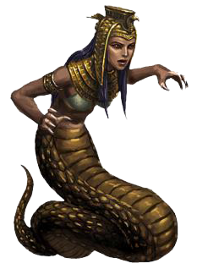
Finally, Lamia has an assortment of skills related to witchcraft. She is a minor sorceress, with the ability to perform small enchantments like turning women invisible or placing a fog over a man’s mind, so that he doesn’t detect anything strange that happens while he’s in her company. She is also able to brew potions for similar purposes.

